Slide 1

Week 4 Project Update
Matthew Vu

Slide 2
Overview: Updates Made to Project
1. Updated Research Questions
2. Updated Literature
3. Found literature on behaviors and habits associated with diabetes
4. Found data consisting of behavioral predictor variables
5. Explored the data using visualizations and hypothesis testing
6. Outline future plans
Notes:
So before I get started on going into detail on some of the changes I made to the overall project topic and plan based on feedback from last class, I would like to give an overview on some of these changes. First, I changed the topic slightly, but more specifically changed what the final application is supposed to do. Second, I altered the topic and the end-goal final product because I wanted to create an application that is actually more useful and has better justification for making it. Third, I revised my literature review section to give better explanation of how my project introduces new ideas. Fourth, I explained, found, and cleaned data that is to be used for my project, which was a rather long process and I’ll explain why later. Fifth, I brainstormed future plans. Finally, I created more comprehensive slides.

Slide 3
Revised Research Questions
What behaviors and habits are associated with diabetes risk?
Can we use these associated behaviors and habits to predict diabetes risk?
What algorithm is best used for this type of problem?

Slide 4
Academic Literature Review: Source 1
Title: “Likelihood Prediction of Diabetes at Early State Using Data Mining Techniques”
Summary: The book chapter describes the methodology of experimenting with data mining techniques, such as Naïve Bayes, Logistic Regression, and Random Forest, to understand if behavioral risk factors can be used to predict diabetes. They used a dataset containing diabetes behavioral risk factors, such as experiencing polyuria (excess urination), polydipsia (excessive thirst), episode of sudden weight loss, and muscle weakness. They discovered with this dataset that Random Forest performed the best. Also, they proposed the creation of a user-friendly application to assess if a person is at risk of diabetes. Although the application was proposed, it was never created.
Ways I can see improvement in research: The data could consist of other predictors that fall more in line with a person’s habits, such as diet, sleep, smoking, etc. They could have included experimentation with supper vector machines (SVMs) and k-nearest neighbor could have been conducted. The application to assess diabetes risk could have been created.
Ways my project introduces new ideas: I will use data that consists of other predictors that fall more in line with a person’s habits, such as diet, alcohol consumption, sleep, smoking, etc. I will experiment with SVMs and k-nearest neighbor.
Citation: Islam M.M., Ferdousi, R., Rahman, S., & Bushra, H. Y. (2019). Likelihood Prediction of Diabetes at Early Stage Using Data Mining Techniques. In Computer Vision and Machine Intelligence in Medical Image Analysis (pp. 113–125). Springer Singapore. https://doi.org/10.1007/978-981-13-8798-2_12
Notes:
Book chapter
Authors: M. M. Faniqul Islam,
Rahatara Ferdousi,
Sadikur Rahman &
Humayra Yasmin Bushra
Conference paper
First Online: 29 August 2019
The book covers the latest trends in computer vision and hybrid machine learning paradigms for medical image analysis

Slide 5
Academic Literature Review: Source 2
Title: "Building Risk Prediction Models for Type 2 Diabetes Using Machine Learning Techniques“
Summary: The academic article describes using multiple machine learning algorithms, such as support vector machine, decision tree, logistic regression, random forest, neural network, and Gaussian Naive Bayes classifiers, to predict the risk of type 2 diabetes. They used a dataset that consisted of predictors describing behavioral and habitual risk factors associated with diabetes, such as difficulty seeing, depression, exercise, smoking, vaccines (flu), and history of heart disease. The dataset was sourced from the CDC’s 2014 Behavioral Risk Factor Surveillance System (BRFSS), which is the system responsible for conducting health-related telephone surveys asking risk behaviors, chronic diseases, and the use of preventative services. They discovered that neural networks gave performed the best with highest AUC.
Ways I can see improvement: The research could conduct experiment with k-nearest neighbor. Also, they could use data that included predictors describing diet, high blood pressure, high cholesterol, and difficulty walking. Furthermore, an application that can deploy their research was not proposed or created.
Ways my project introduces new ideas: I will also experiment with k-nearest neighbor. Also, I will use data that includes predictors describing diet. Furthermore, I will deploy my research in the form of a risk assessment application.
Citation: Xie, Z., Nikolayeva, O., Luo, J., & Li, D. (2019). Building Risk Prediction Models for Type 2 Diabetes Using Machine Learning Techniques. Preventing Chronic Disease, 16. https://doi.org/10.5888/pcd16.190109

Slide 6
Data Part 1: Metadata
Name: Diabetes Health Indicators Dataset
Distributor: Alex Teboul
Description: The dataset consists of 70, 692 survey responses to the CDC’s 2015 Behavioral Risk Factor Surveillance System (BRFSS) Health Survey. It contains 21 predictor variables that are commonly known to be related to diabetes, such as habits, behaviors, and chronic diseases. The observations contained within the dataset are balanced, meaning there is a 50-50 split between observations that have diabetes and do not. This was done by randomly sampling 35, 346 observations with and without diabetes from the BRFSS Health Survey.
File Type and Size: The dataset comes in the form of a 6.05 MB .csv file with 70, 692 rows and 22 columns.
Reason for use: The data consists of predictors describing each person’s habits, behaviors, and chronic disease (including diabetes).
Citation: Teboul, Alex (2019). Diabetes Health Indicators Dataset [Data set]. kaggle. https://www.kaggle.com/datasets/alexteboul/diabetes-health-indicators-dataset?select=diabetes_binary_5050split_health_indicators_BRFSS2015.csv
Notes:
Hence why a large number of Kaggle challenges use the Pima Indians Diabtes dataset, we saw from past research.
Associate Clinical Professor, Department of Internal Medicine at Virginia Commonwealth University School of Medicine
Name: Diabetes Dataset
Contributor: Ahlam Rashid
Description: The dataset consists of health data pertaining to 1000 Iraqi patients. Data extracted from the patient’s health files to construct this dataset. The data collection and processing steps were done by the Laboratory of Medical City Hospital, Specialized Center for Endocrinology, and Diabetes-Al-Kindy Teaching Hospital. However, the dataset was shared and posted by Ahlam Rashid on Mendeley Data.
File Type and Size: The dataset comes in the form of a 49 KB .CSV file with 1000 rows.
Citation: Rashid, Ahlam (2020). Diabetes Dataset (V1) [Data set]. Mendeley Data. https://data.mendeley.com/datasets/wj9rwkp9c2/1

Slide 7
Data Part 2: Data Dictionary
Diabetes_binary = Has diabetes?
HighBP = Has been told they have high blood pressure by a doctor, nurse, or other health professional
HighChol = Has EVER been told by a doctor, nurse or other health professional that their blood cholesterol is high
CholCheck = Has had their cholesterol checked within past five years
BMI = Body mass index
Smoker = Has smoked at least 100 cigarettes in your entire life
Stroke = Had a stroke
HeartDiseaseorAttack = Had a coronary heart disease or myocardial infarction
PhysActivity = Reported doing physical activity or exercise during the past 30 days other than their regular job
Fruits = Consumes fruit one or more times per day
Veggies = Consumes vegetables one or more times per day
HvyAlcoholConsump = Heavy drinkers (adult men having more than 14 drinks per week and adult women having more than 7 drinks per week)
AnyHealthcare = Has any kind of health care coverage, including health insurance, prepaid plans such as HMOs, or government plans such as Medicare, or Indian Health Service
NoDocbcCost = There was a time in the past 12 months when they needed to see a doctor but could not because of cost
GenHlth = General health (Excellent, very good, good, fair, Poor; 1, 2, 3, 4, 5)
MentHlth = How many days during the past 30 days was their mental health not good
PhysHlth = How many days during the past 30 days was their physical health not good
DiffWalk = Has serious difficulty walking or climbing stairs
Sex = Sex
Age = Age category (must be of 18 years or older and categories are organized in increments of 5 years)
Education = Highest grade or year of school completed (never, elementary, some high school, high schoole, some college, college; 1, 2, 3, 4, 5, 6)
Income = income level category (<10, 000, <15,000, <20,000, <25,000, <35,000, <50,000, <75,000, >75,000; 1, 2, 3, 4, 5, 6, 7, 8
Diabetes_binary | HighBP | HighChol | CholCheck | BMI | Smoker | Stroke | HeartDiseaseorAttack | PhysActivity | Fruits | Veggies | HvyAlcoholConsump | AnyHealthcare | NoDocbcCost | GenHlth | MentHlth | PhysHlth | DiffWalk | Sex | Age | Education | Income
0 | 1 | 0 | 1 | 26 | 0 | 0 | 0 | 1 | 0 | 1 | 0 | 1 | 0 | 3 | 5 | 30 | 0 | 1 | 4 | 6 | 8
0 | 1 | 1 | 1 | 26 | 1 | 1 | 0 | 0 | 1 | 0 | 0 | 1 | 0 | 3 | 0 | 0 | 0 | 1 | 12 | 6 | 8
0 | 0 | 0 | 1 | 26 | 0 | 0 | 0 | 1 | 1 | 1 | 0 | 1 | 0 | 1 | 0 | 10 | 0 | 1 | 13 | 6 | 8
0 | 1 | 1 | 1 | 28 | 1 | 0 | 0 | 1 | 1 | 1 | 0 | 1 | 0 | 3 | 0 | 3 | 0 | 1 | 11 | 6 | 8
0 | 0 | 0 | 1 | 29 | 1 | 0 | 0 | 1 | 1 | 1 | 0 | 1 | 0 | 2 | 0 | 0 | 0 | 0 | 8 | 5 | 8
Table 1: The first 5 rows of the “Diabetes Health Indicators Dataset” . Data source: https://www.kaggle.com/datasets/alexteboul/diabetes-health-indicators-dataset
Notes:
390 observations 16 variables. 13numerial and 3 factor variables (ID, Diabetes, and gender).

Slide 8
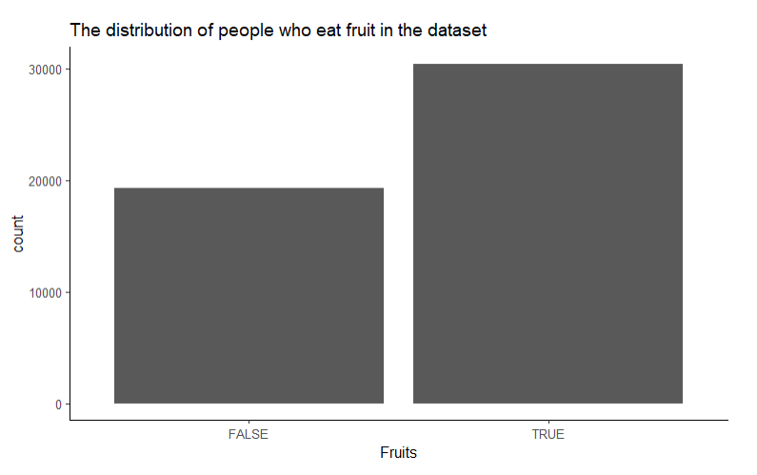
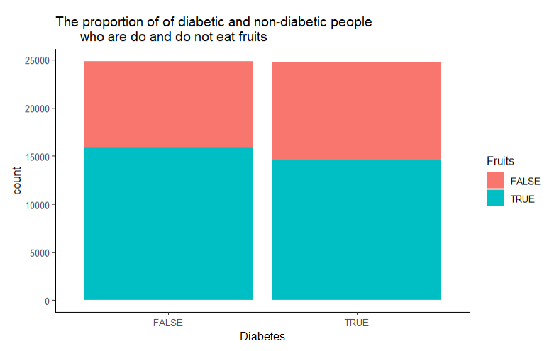
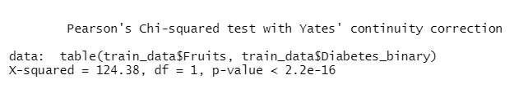
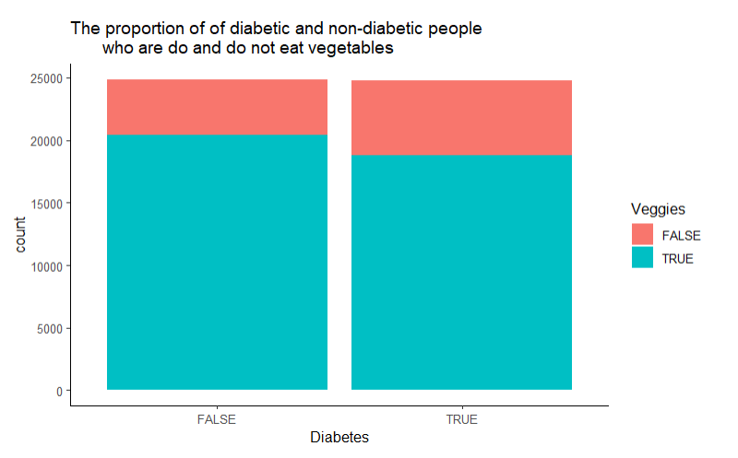
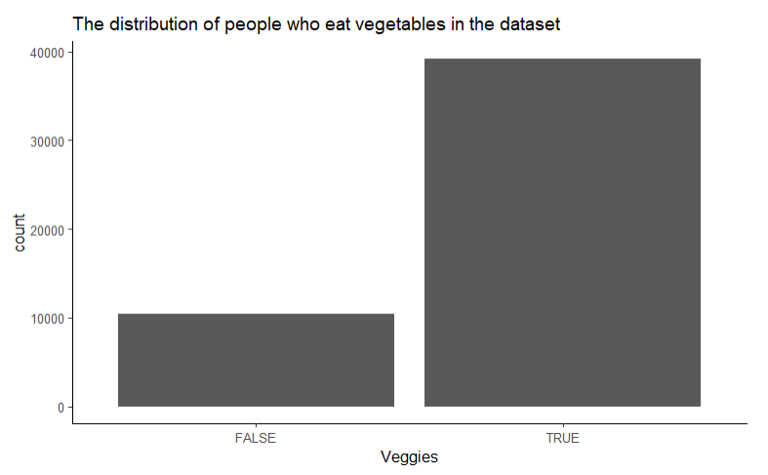
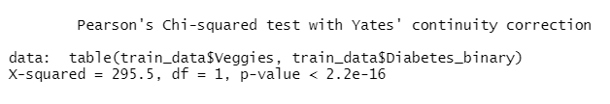
Exploratory Data Analysis Part 1: Diet

Slide 9
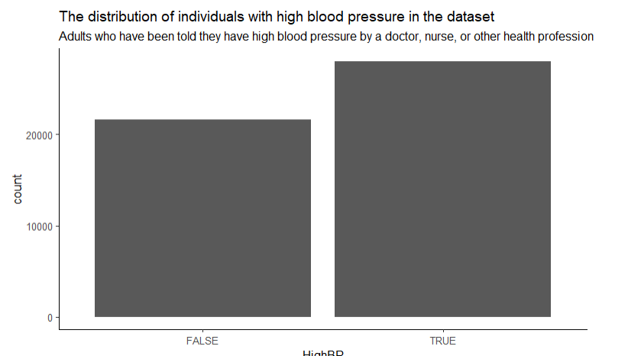
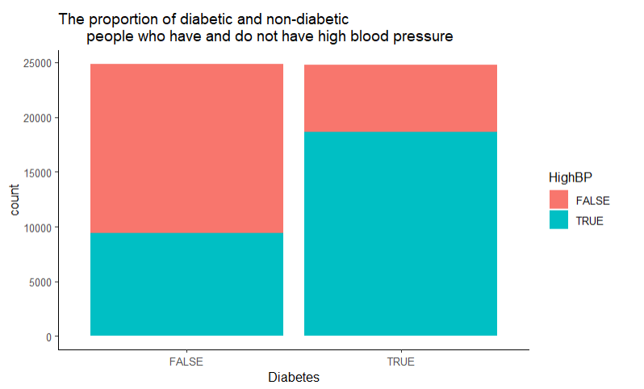

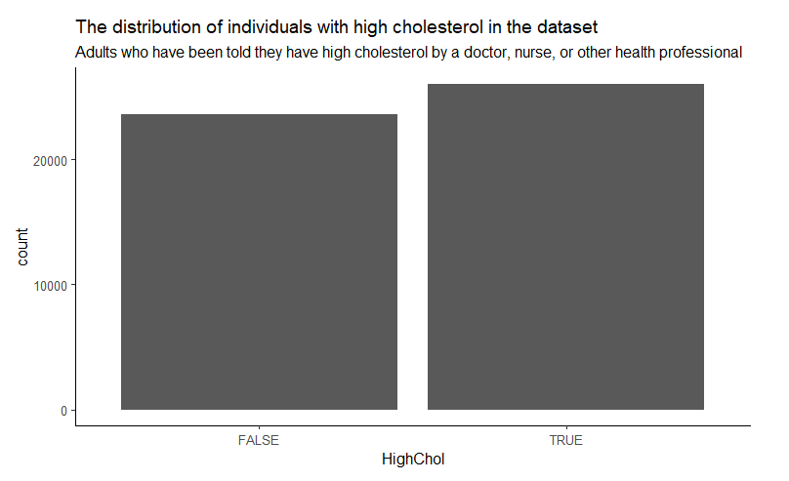
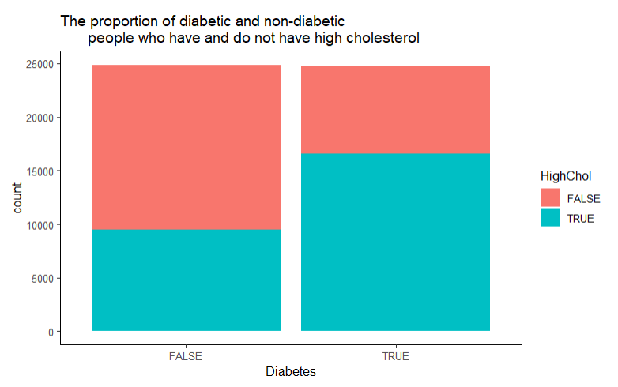
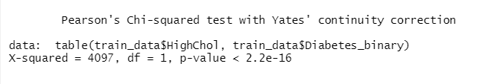
Exploratory Data Analysis Part 2: High Blood Pressure and High Cholesterol

Slide 10
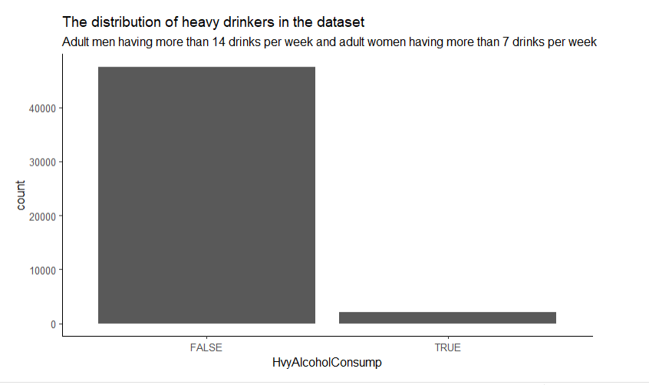
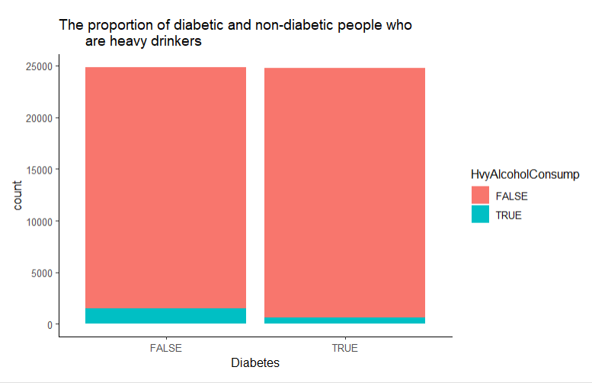
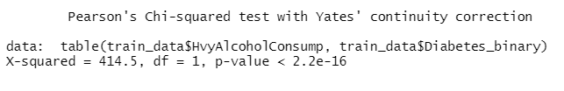
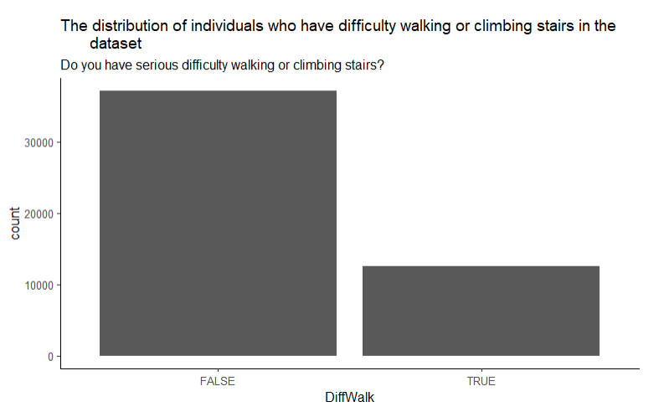
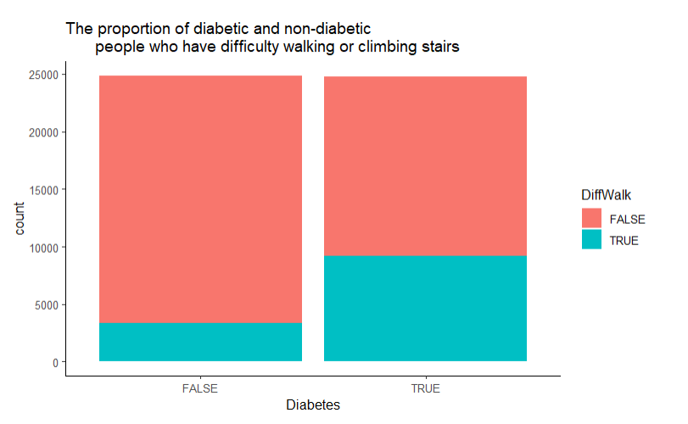
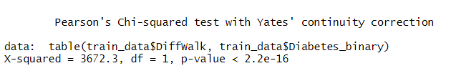
Exploratory Data Analysis Part 3: Heavy Alcohol Consumption and Difficulty Walking
Notes:
This is strange because alcohol has a lot of sugar, which can equate to diabetes. However, it makes sense that there are a greater proportion of non-diabetic people who are heavy drinkers than diabetic people because when people have diabetes, they do not want to drink because it might kill them. As a result, this variable might not be the best variable to continue on with our analysis. Also, this might be caused by the fact that so few observations are heavy drinkers. A better variable might be "have you been a heavy or binge drinker in the past".

Slide 11
Future Plans
Explore the data some more
Analyze more variables that can be inputted from the BRFSS dataset that the Diabetes Health Indicators Dataset was derived from
Begin training logistic regression, naïve bayes, support vector machines, k-nearest neighbor, and decisions trees algorithms

